Slide 1
E- Adoption To Reduce Death Mortality
*Joy Gomes - 001084949
*Leela Venkata Ravi Kumar Kanthi - 001023809
*Shreyas Redij - 001053076

Slide 2
Problem Overview
Every year thousands of families plan on adopting a child while another thousands plan on aborting a pregnancy.
Questions such as
Should I adopt a newborn?
How can I adopt?
These questions could be overcome, from one helping hand to another through our Adoption Application

Slide 3
Reasons For a mother to abort child
Not financially prepared: 40 percent
Bad timing, not ready, or unplanned: 36 percent
Partner-related reasons (including the relationship is bad or new, she doesn't want to be a single mother, her partner is not supportive, does not want the baby, is abusive, or is the wrong guy): 31 percent
Need to focus on her other children: 29 percent
Not emotionally or mentally prepared: 19 percent
Interferes with educational or vocational plans: 20 percent
Health-related reasons (includes concern for her own health, the health of the fetus, use of prescription or non-prescription drugs, alcohol, or tobacco): 12 percent
Want a better life for a baby than she could provide 12 percent
Not independent or mature enough for a baby: 7 percent
Influences from family or friends: 5 percent
Doesn't want a baby or to place the baby for adoption: 4 percent

Slide 4
Solution
E-Adoption is a Powerful Ecosystem application that personally assist you, step by step, through the adoption process.
E-Adopting is all about adopting a newborn by proper decision making, paperwork, and a full range of supportive services, all designed to make the transition of growing your family as smooth as possible.
The main objective of this E-system is to allow mothers during their pregnancy to get in touch with families that desire to start a new family
Proper counseling and monetary support will be provided to the birth mother and parent

Slide 5
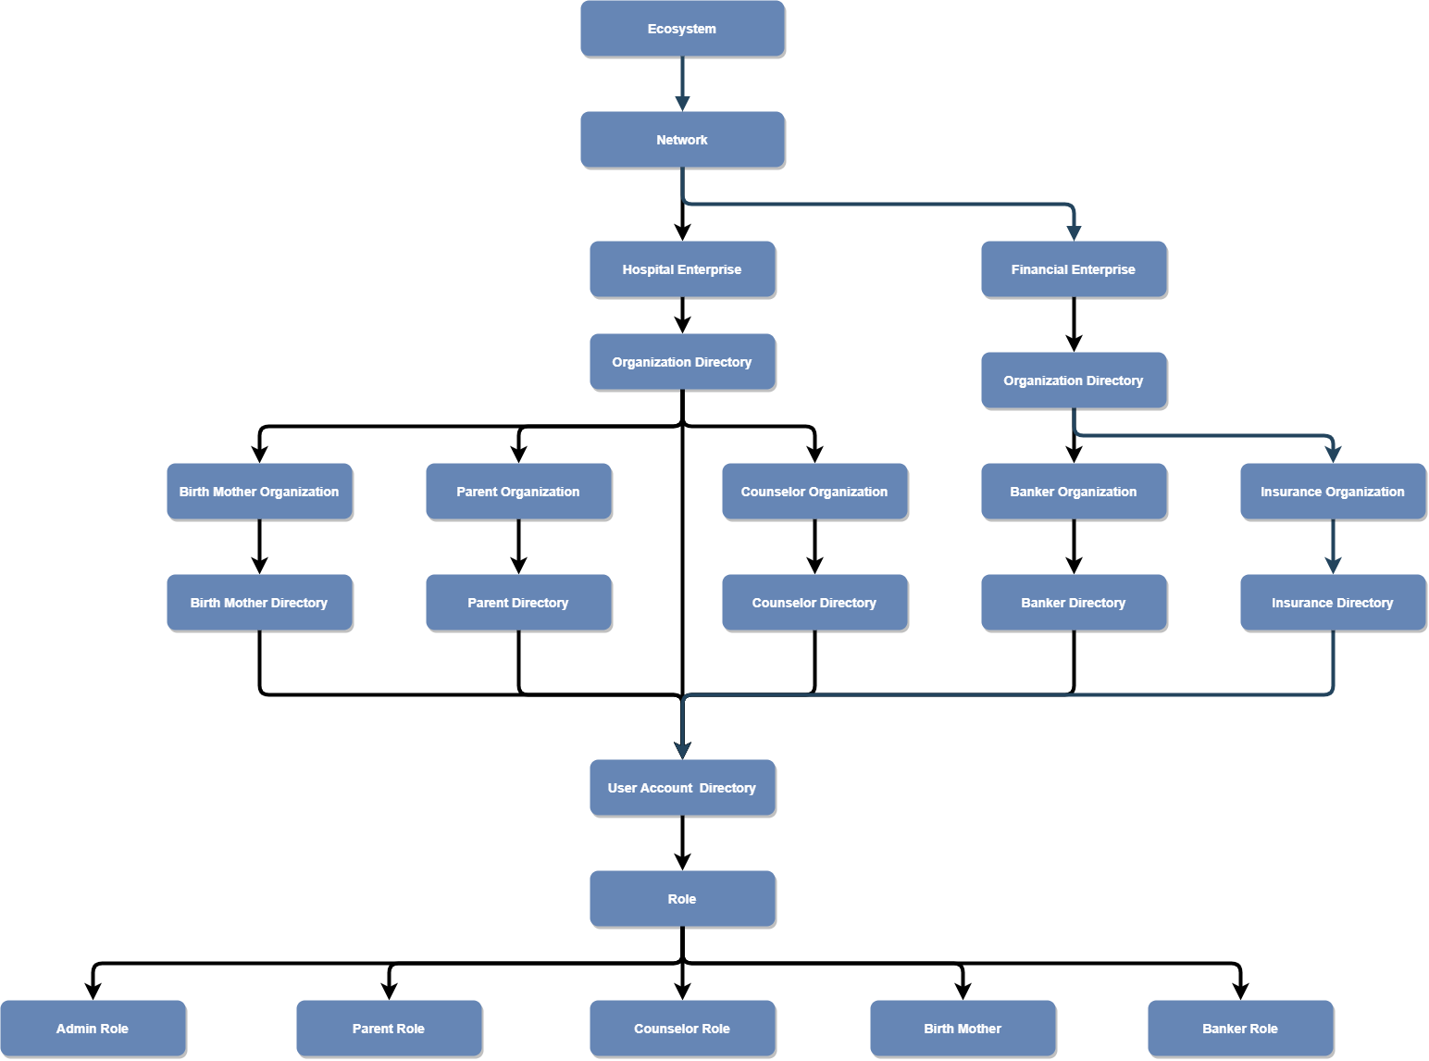
Eco-System Architecture Diagram

Slide 6
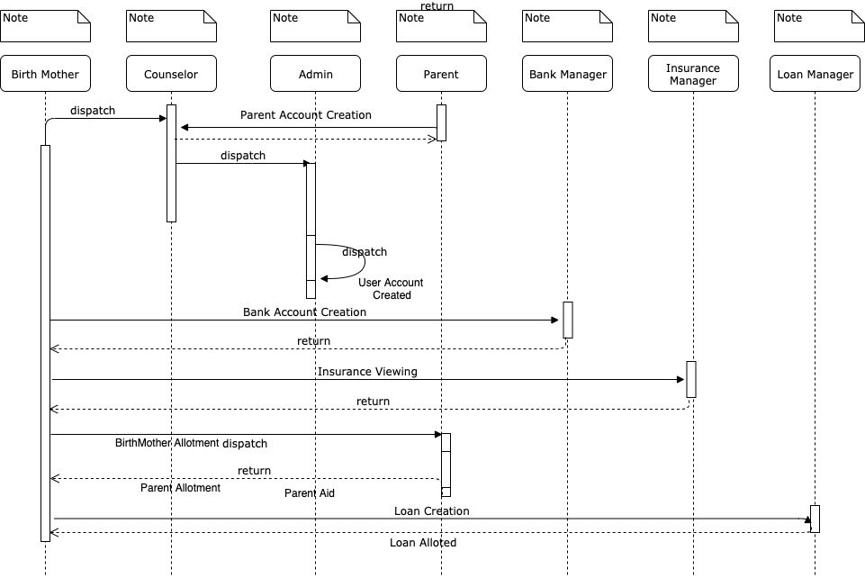
UML Diagram

Slide 7
Use Cases
Health Enterprise
The birth mother who is in a dilemma to abort or give birth to the child would need to create a profile as she visits the Hospital. A counselor would be assigned to the birth mother by the admin.
The Counselor plays a vital role as they approve the family after scrutinizing their documents. Each case is handled individually by the counselor and they maintain a check on the patient’s well-being and health.
Counselor gives the birth mother all the valid reasons to go ahead with the pregnancy
The mother takes her decision to either abort or go ahead with the pregnancy after the completion of the counselling.
After her decision to proceed with the pregnancy a list of families looking to adopt would be displayed in the application.

Slide 8
Use Cases (Cont)
Financial Enterprise
Through the application the mother can request for monetary help from banks, receive funds from the chosen adoptive parents
The bank approves funds requested by the mother based on the financial documents submitted by the mother.
The amount would be transferred to the Birth Mother by the bank after the approval is complete.
Birth mother can view the funds reports, funds transferred by the adoptive parents.
Birth mother can use financial aid provided by the parents or can request funds like Insurance/Loan from the bank.

Slide 9
Roles
work Flow
1
Birth Mother
Parent
2
Counselor
3
Hospital Admin
4
Banker
Admin
Counselor
Birth mother
Parent
Banker

Slide 10
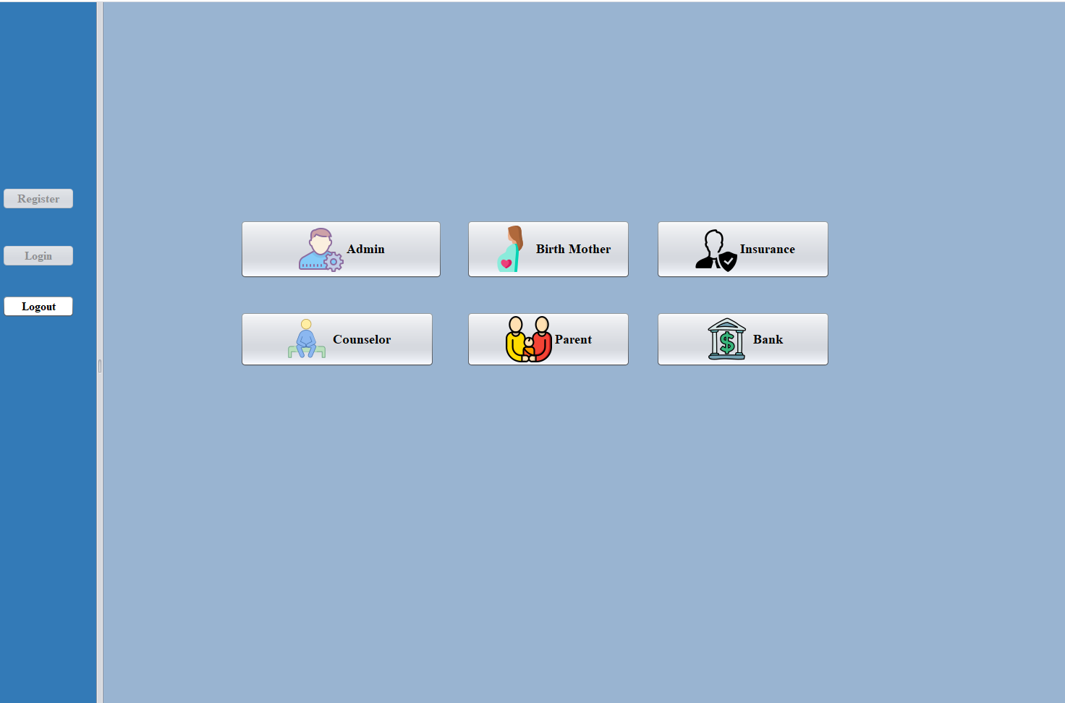
Primary Stakeholders

Slide 11
Unique Features
Customized Dialog button with GIF icons enabled
Email Triggered from the application’s personalized Email id to the recipient's mail id
Pie Charts depicting the Financial Support provided to the Birth Mother
Dynamic Progress Bar set for transferring funds from Parent to Birth Mother

Slide 12
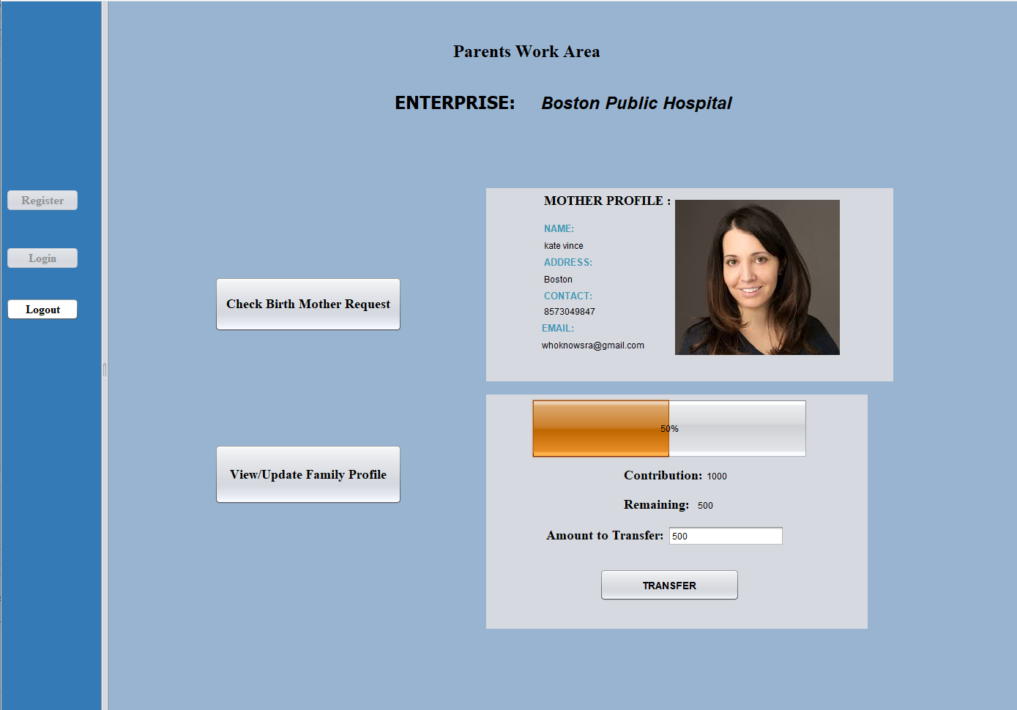
parent to Birth mother Funds transfer

Slide 13
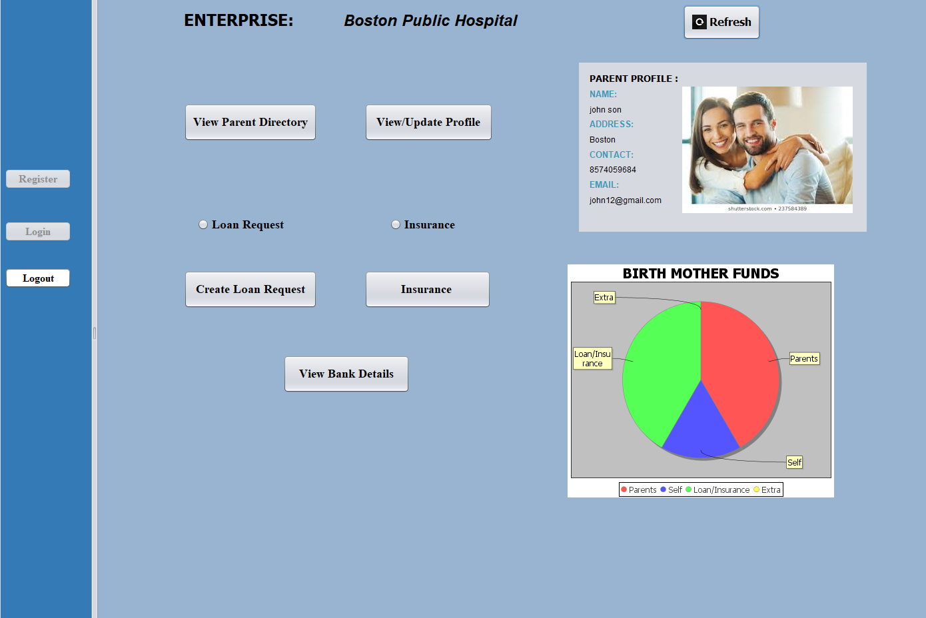
Birth mother funds process

Slide 14
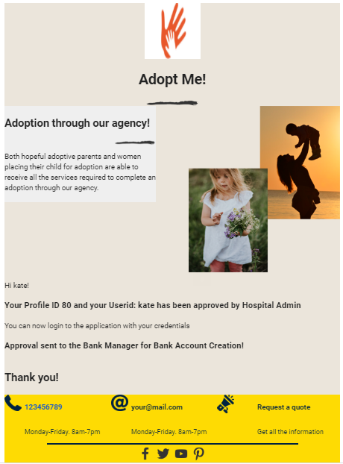

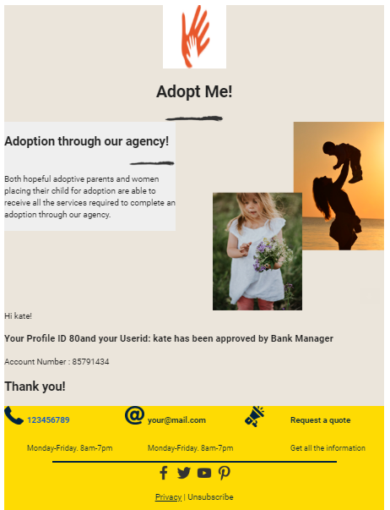
E-mail Notification at every step
Hospital Admin Approval
Counselor Approval
Bank Approval

